Slide 1
Earthquake Analysis – Impact simulation(Southern Alaska)
Meghan Kulkarni

Slide 2
Introduction
Earthquakes are major source of disasters as losses are exponential
Main purpose for project was to simulate earthquake impact using geostatistical interpolations
Southern Alaska was chosen as study area for this project. Earthquake details:
Magnitude : 9.2 (Richter Scale)
Time : 1964-03-28 03:36:16 UTC
GPS Location : 60.908⁰N 147.339⁰W
Depth : 25km

Slide 3
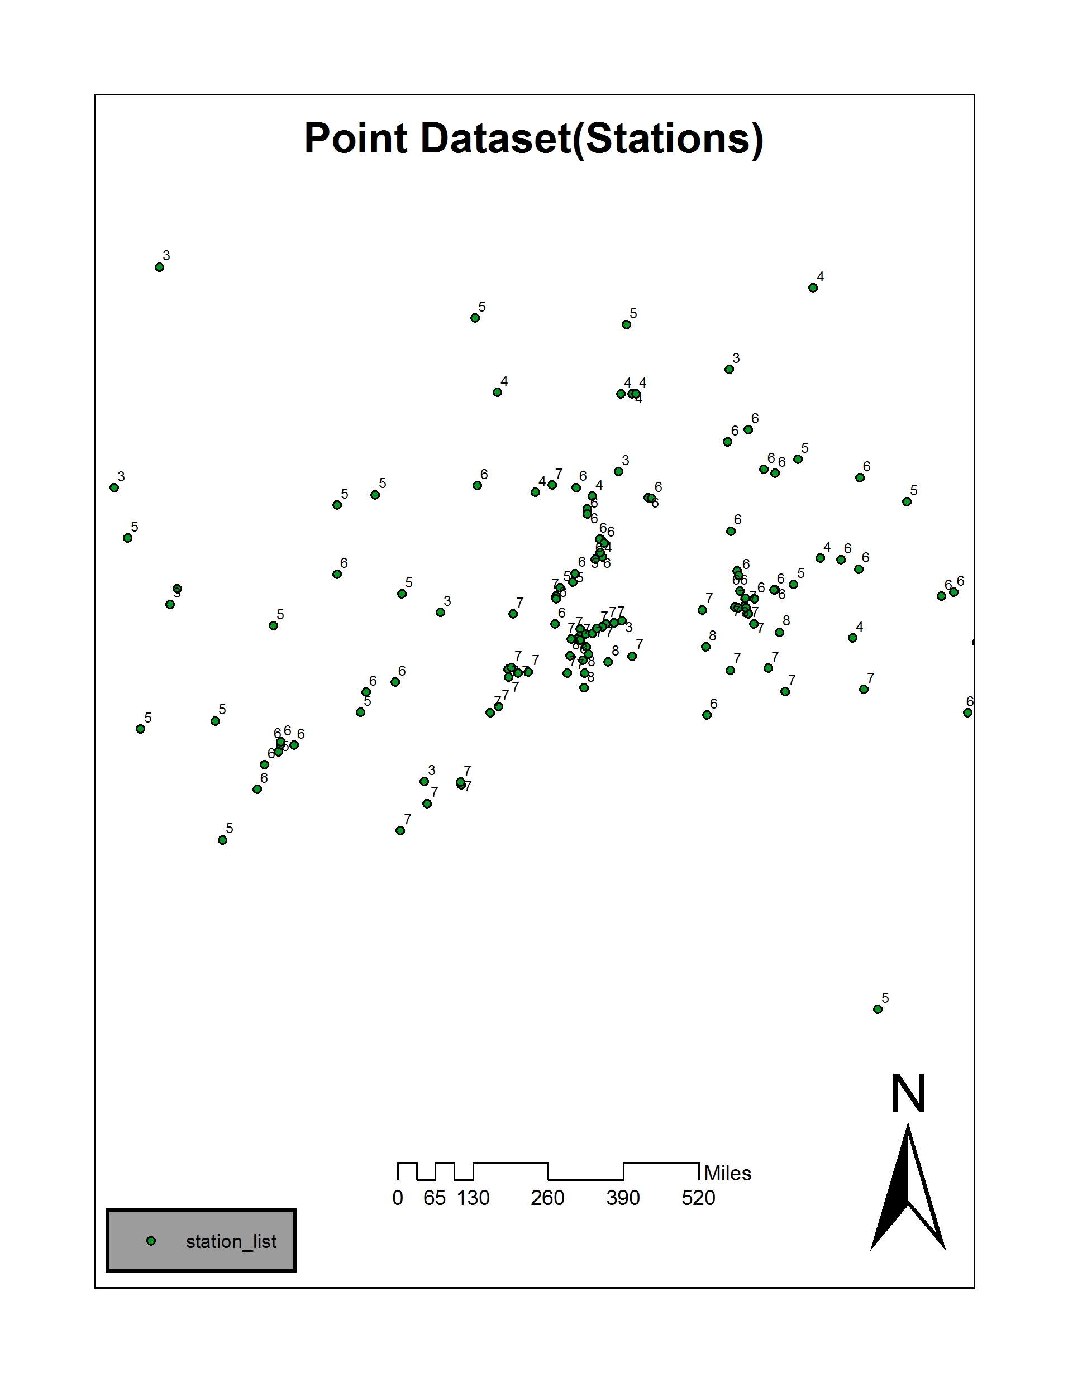
Problem Statement
Creating an impact simulation based on point locations also known as stations
These point locations contained earthquake impact on Richter scale

Slide 4
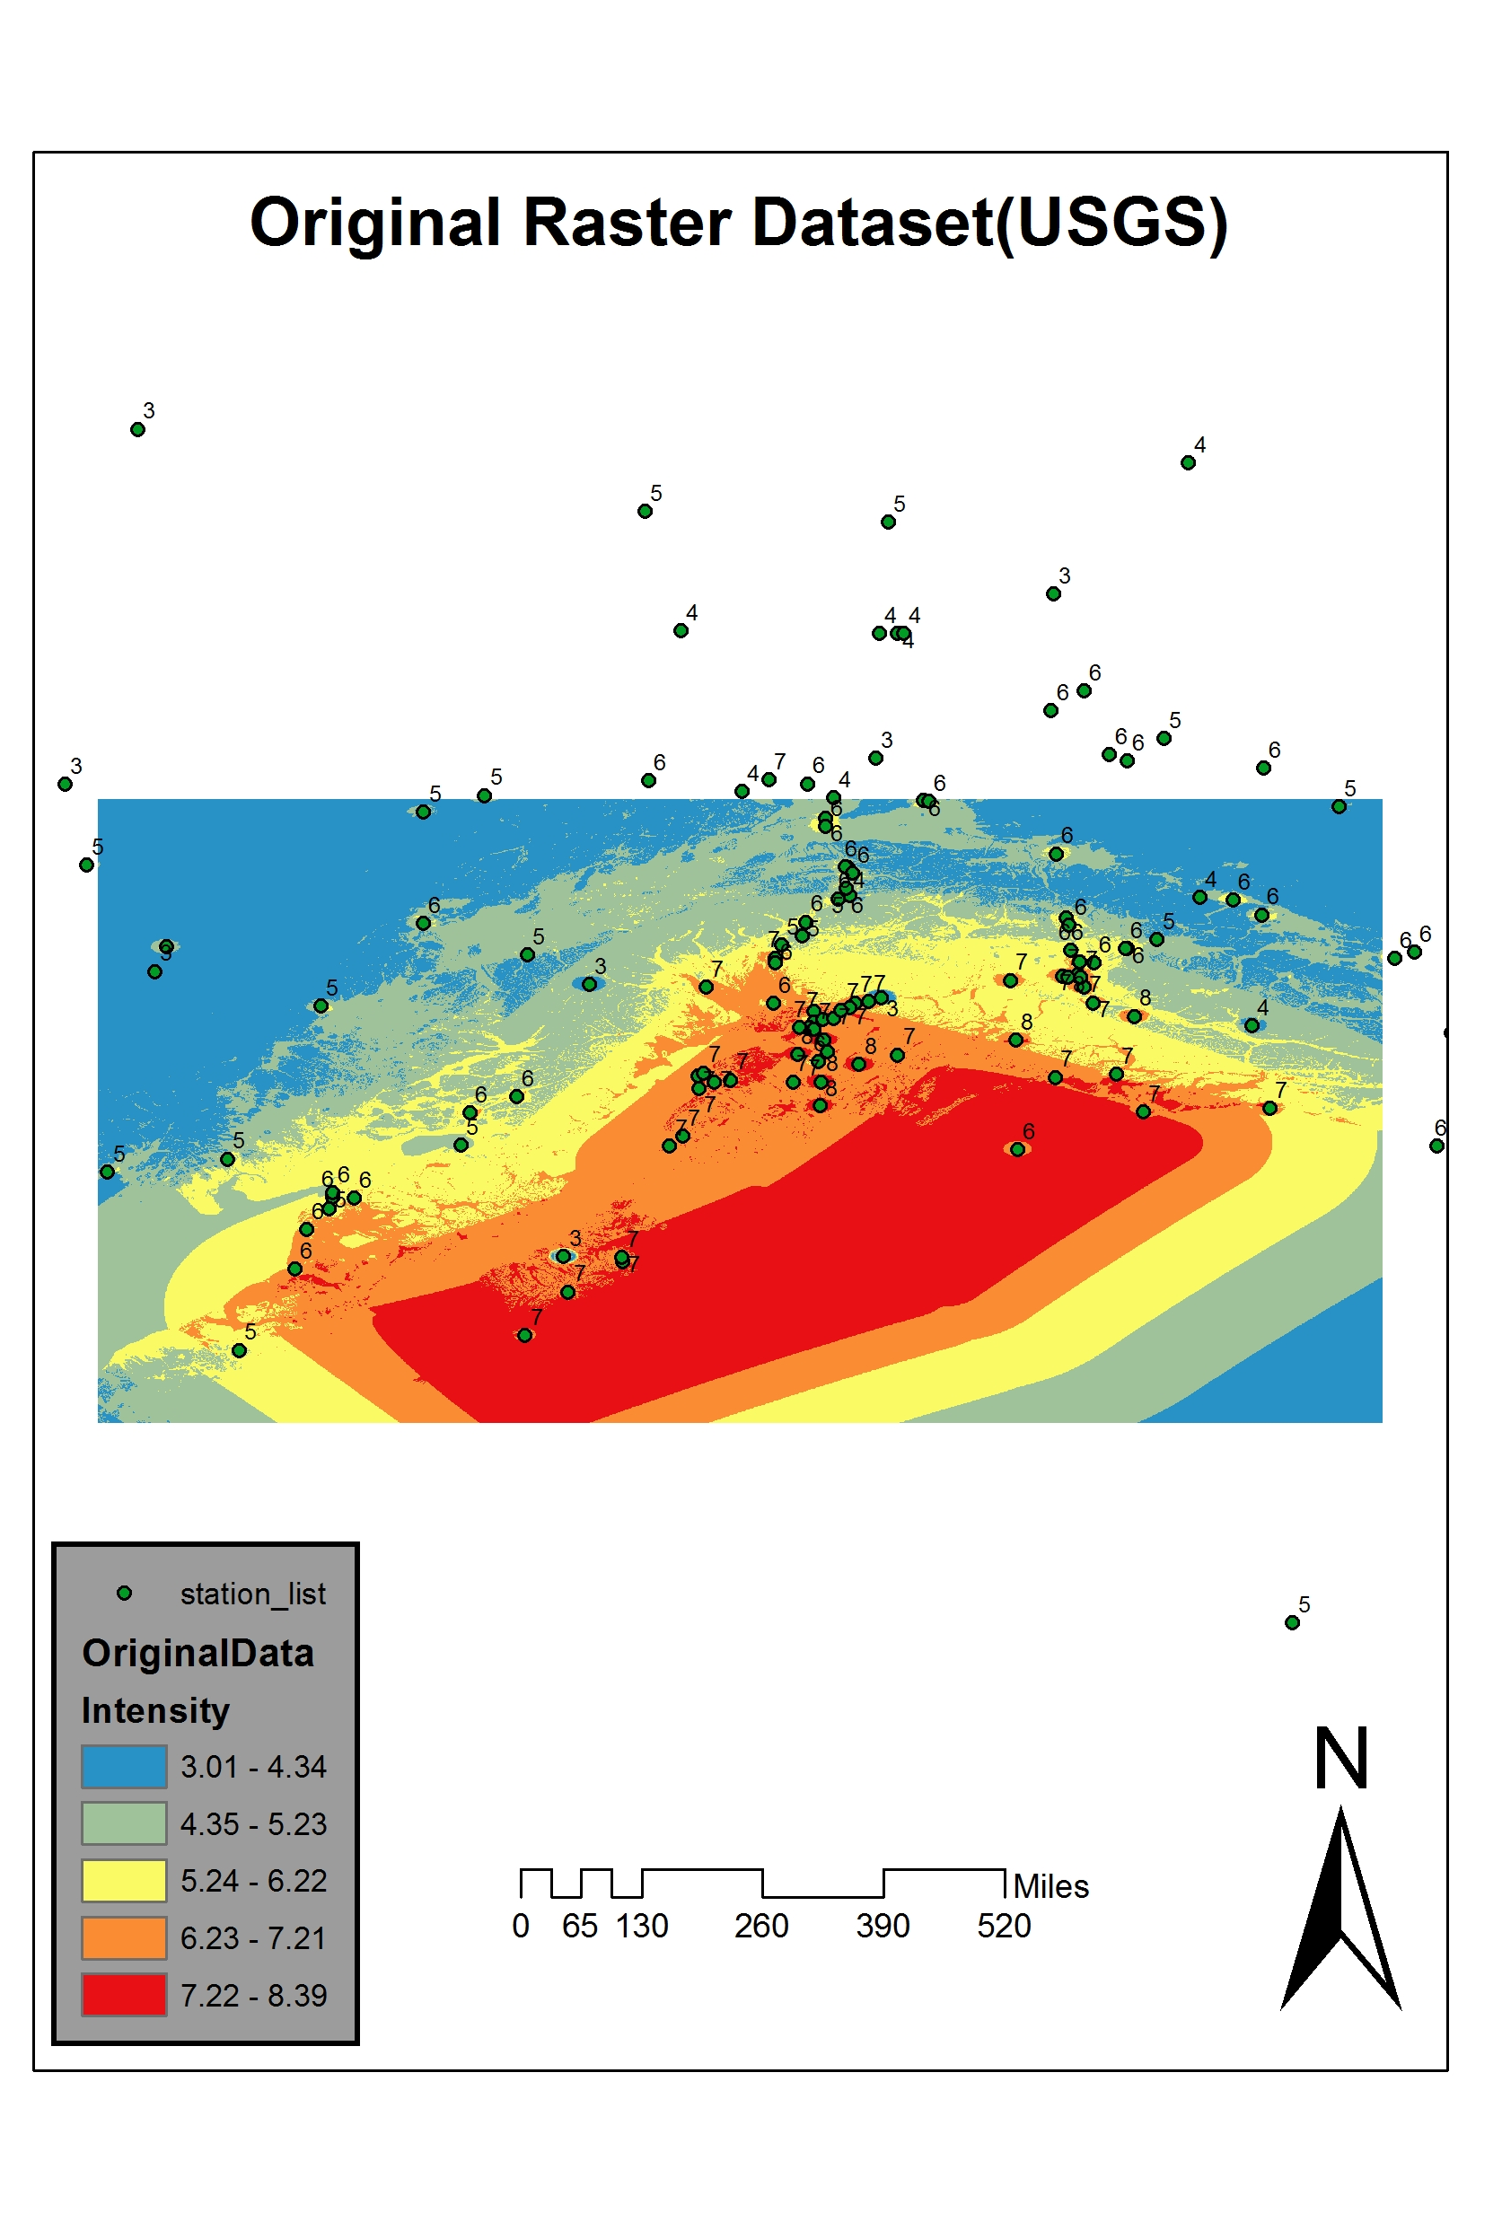
Problem Statement
Final shake map data collected from USGS web site
Main objective for this project was to simulate/reproduce result

Slide 5
Data Collection
Source of data such as:
1. Point observation locations (stations) having GPS coordinates
2. Shake map for study area both in raster and vector format
3. Metadata such as depth of earthquake, Peak Ground Acceleration(PGA), Peak Ground Velocity(PGV)
Above mentioned data was collected from USGS web site. Hyperlink below:
https://earthquake.usgs.gov/data/

Slide 6
Methodology
This project can be broken down into below steps:
Extract point locations in CSV format from USGS
Import CSV file into ArcMap
Use ArcMap’s Display XY tool to create point locations(stations) shapefile
Use Define Projection tool to project these points into GCS_WGS_1984
Create Thiessen polygons around these point locations
Use Geostatistical analyst's IDW tool to create interpolated earthquake analysis
Use map algebra tool to create difference between IDW raster and original raster from USGS
Use map algebra to add raster created above with IDW raster to create final output

Slide 7
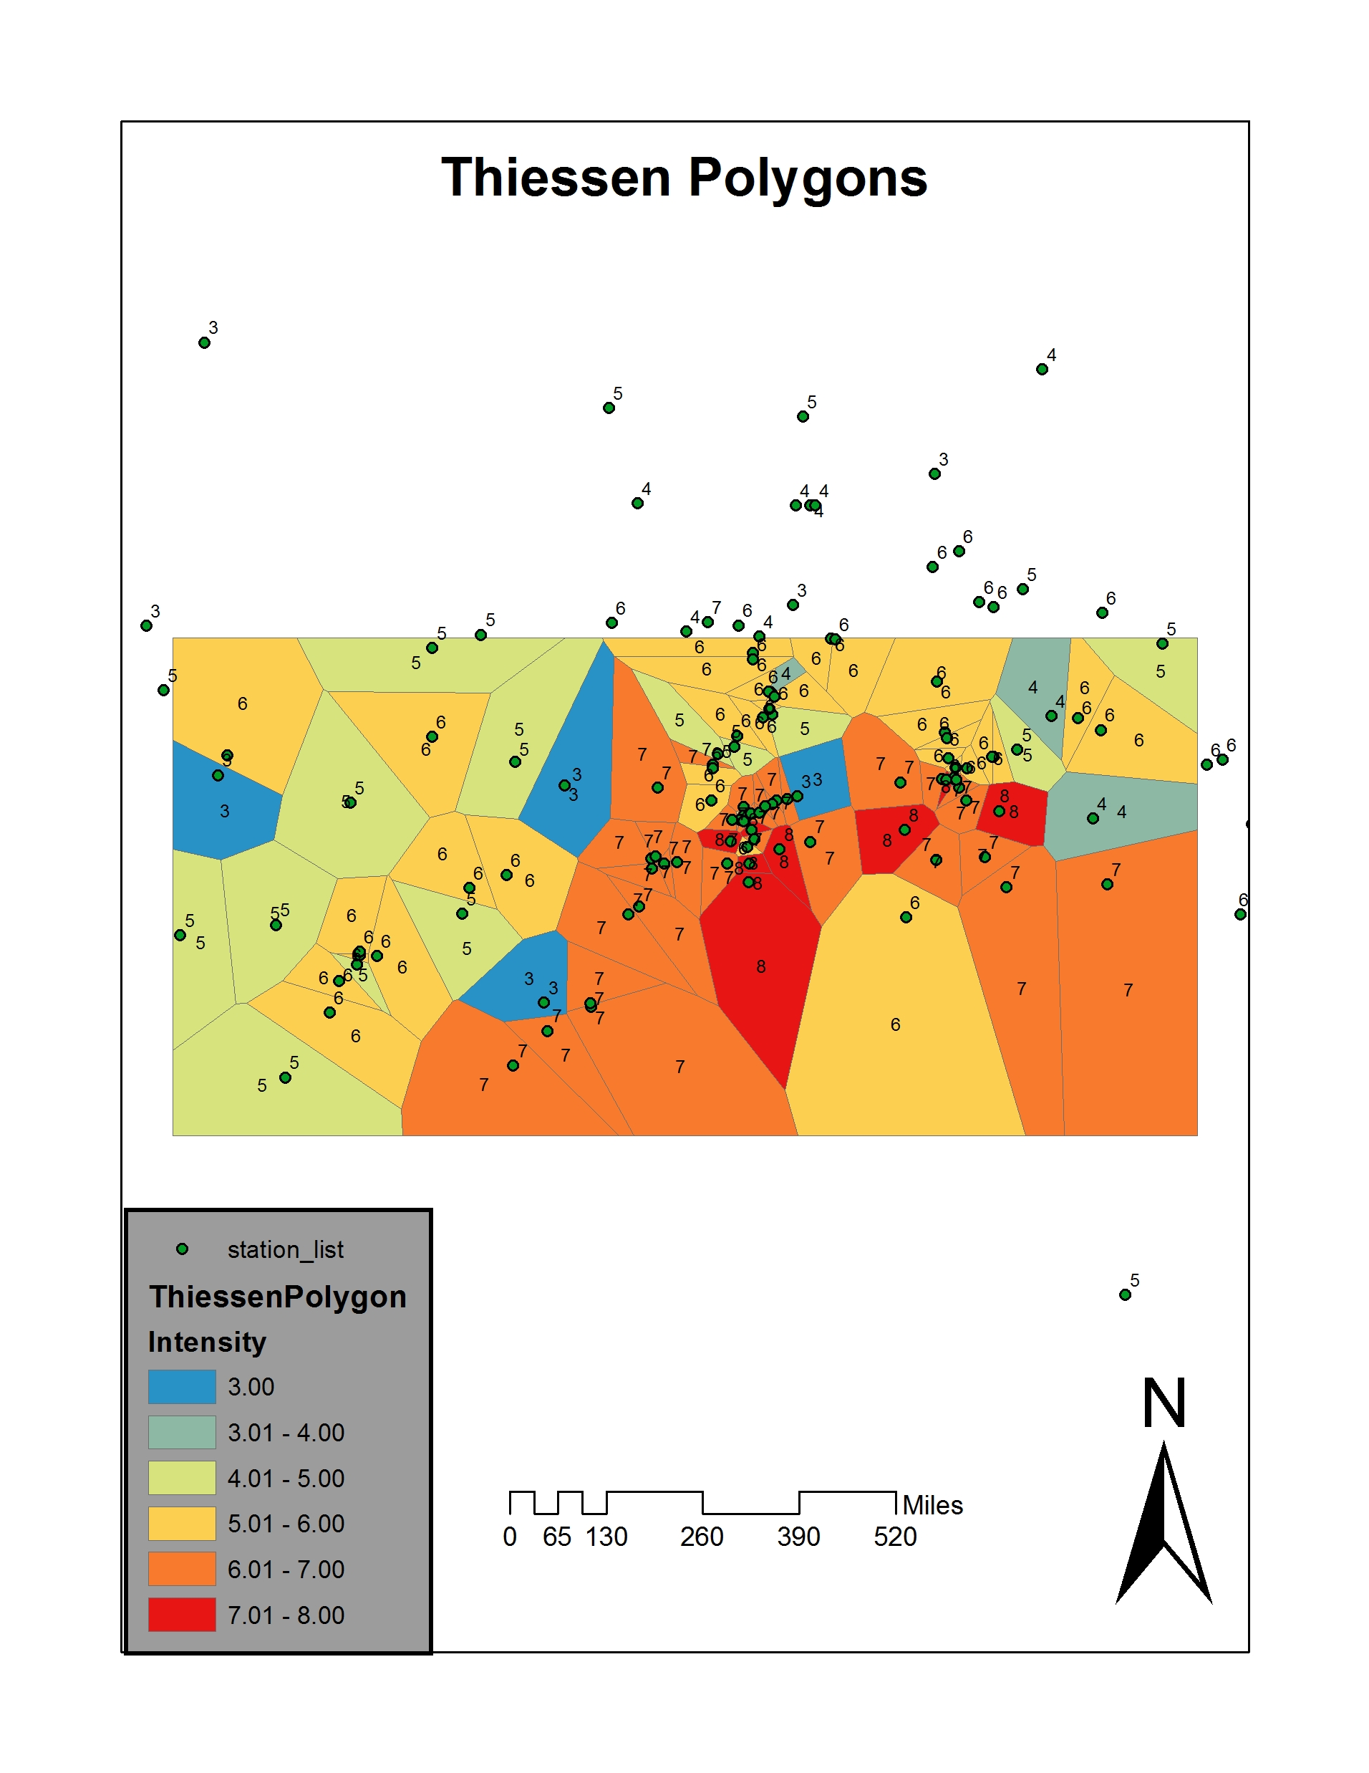
Results
Thiessen polygon creation
Analysis Tools -> Proximity -> Create Thiessen Polygons

Slide 8
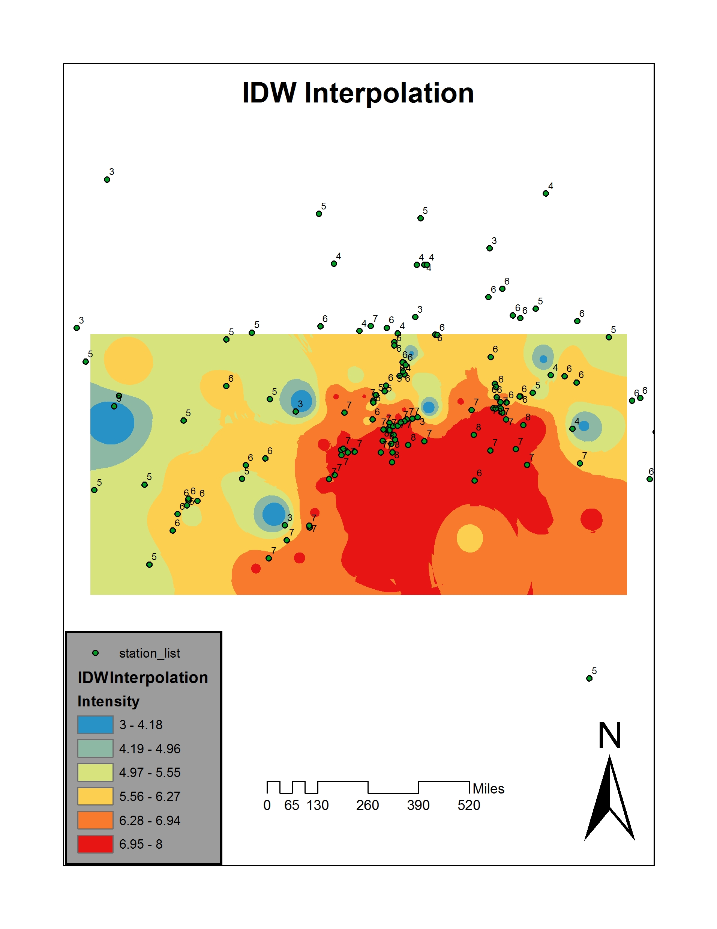
Results
IDW buffer creation around Thiessen Polygon
Geostatistical Analyst Tools -> Interpolation -> IDW

Slide 9
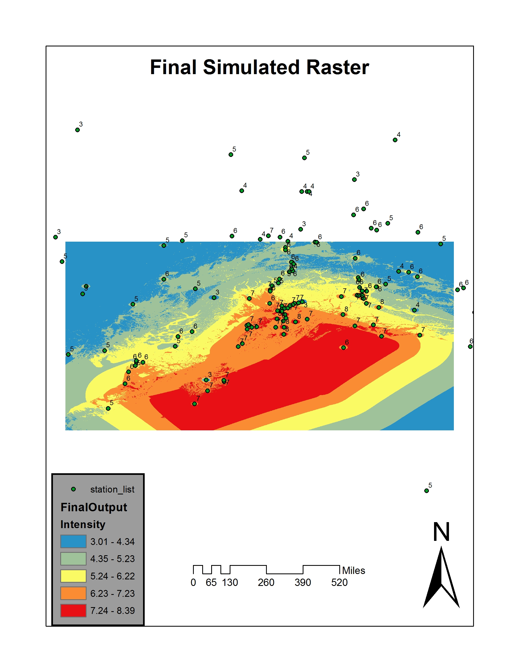
Results
Difference, Addition onto IDW raster to create simulated output
Spatial Analyst Tools -> Map Algebra -> Raster Calculator

Slide 10
References
Required data collected from a Single source
USGS "Data and Products." U.S. Geological Survey. USGS, 03 May 2017. Web.
ArcMap(10.4.1) tool reference information
ESRI. "Create and Share Maps, Analytics, and Data." ArcGIS Desktop. ESRI, Web.

